Slide 3
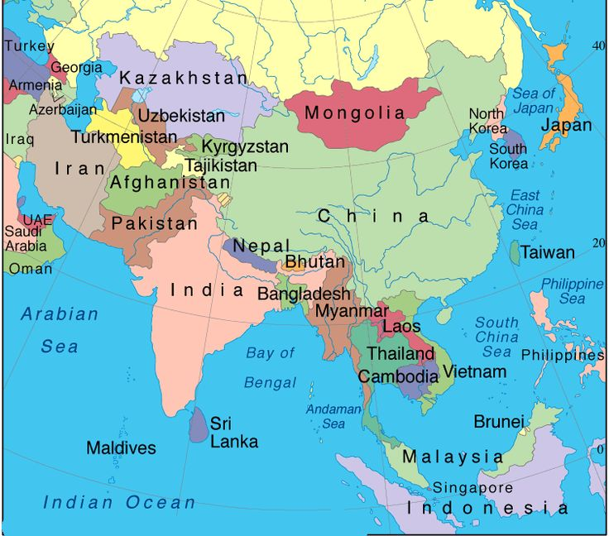

Slide 5
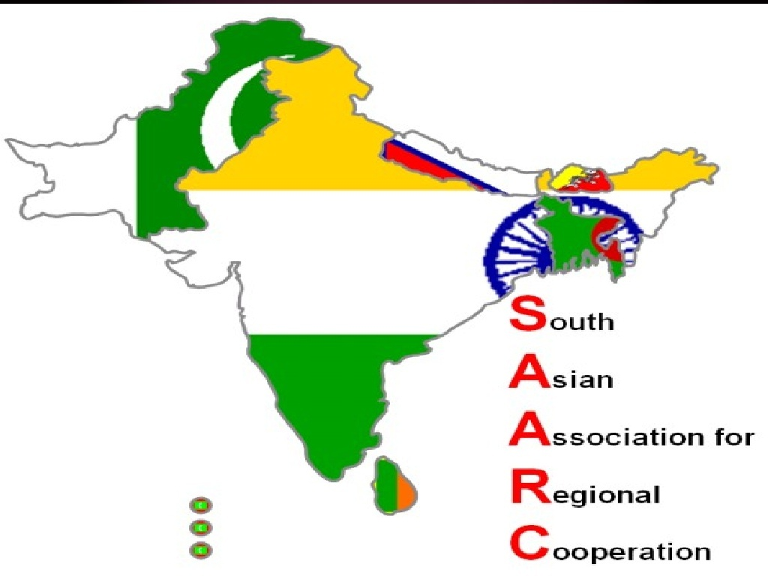

Slide 7
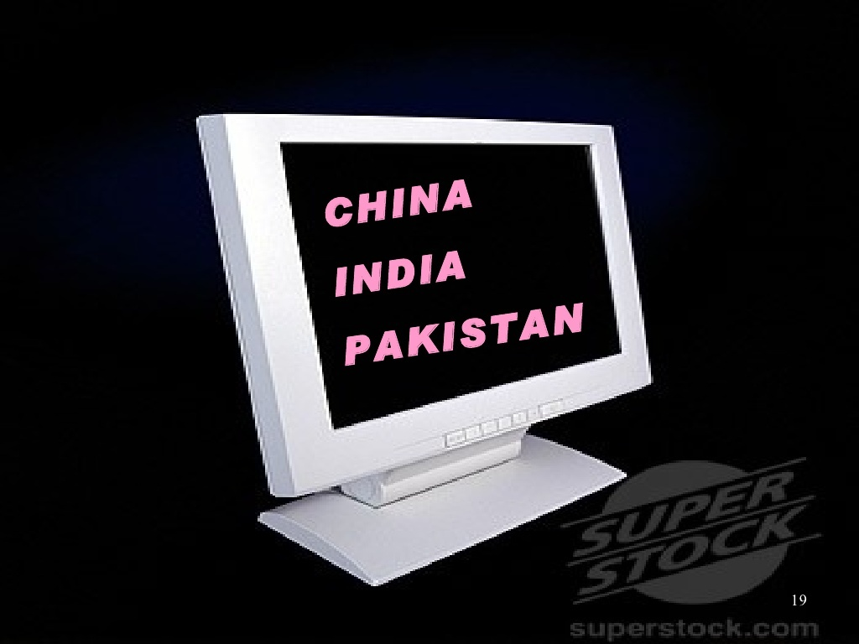

Slide 9
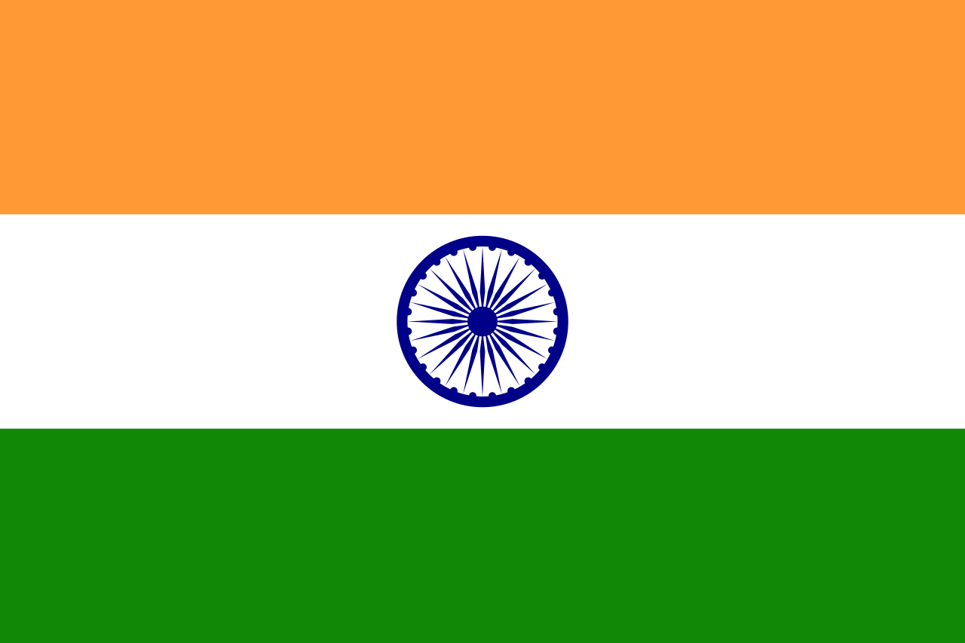
lets look into the developmental path of these three countries .

Slide 12
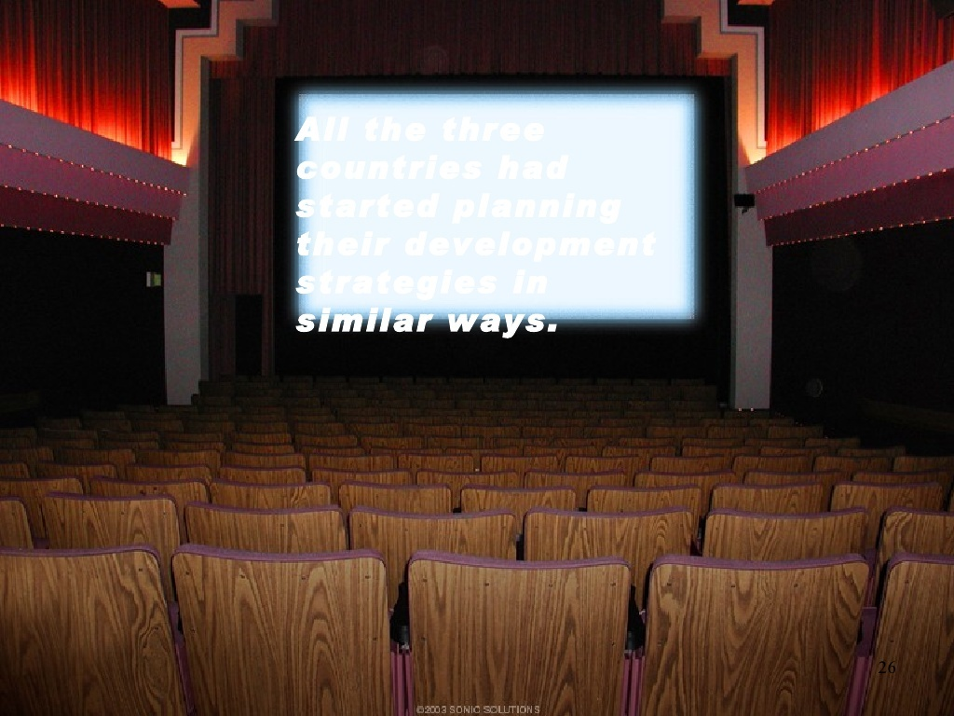
All the three countries had started planning their developmental strategies in similar ways

Slide 17
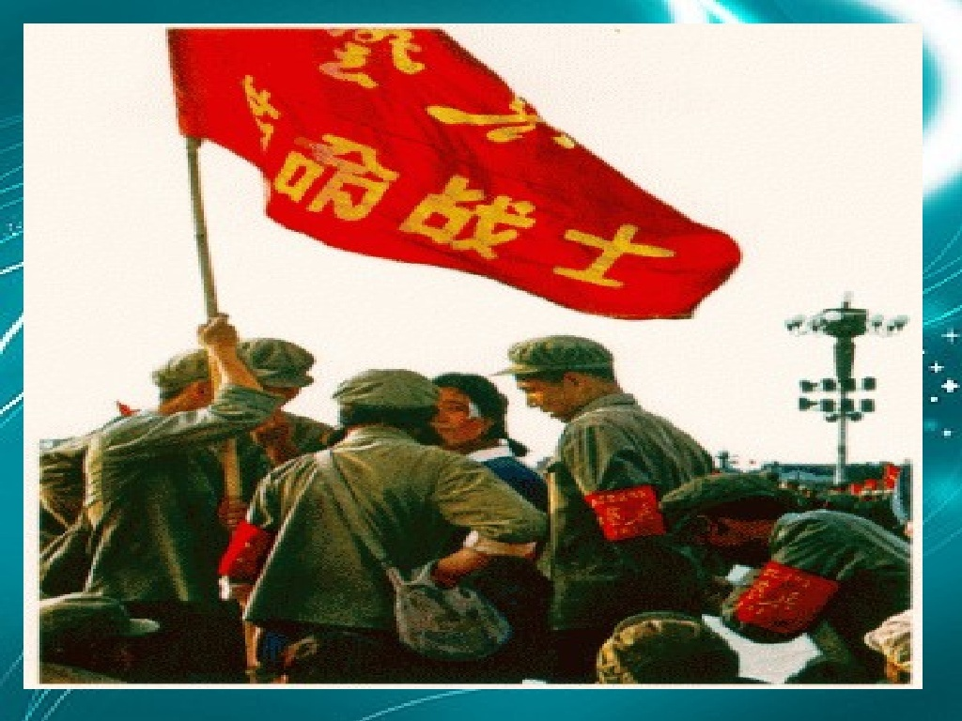

Slide 20
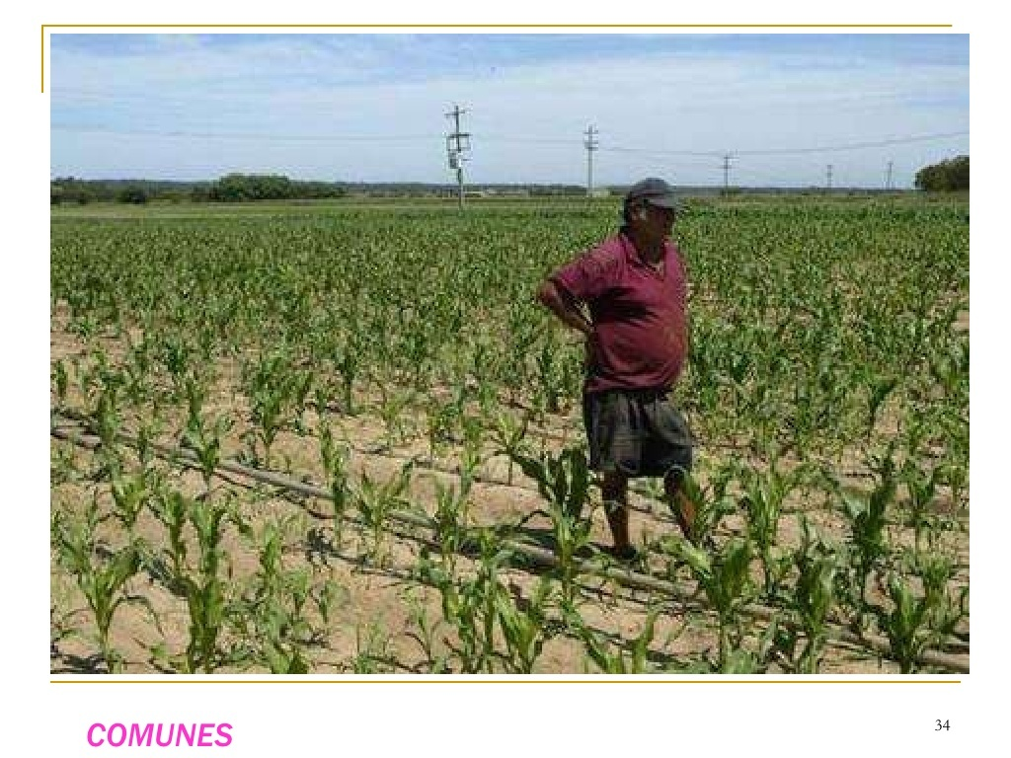

Slide 23
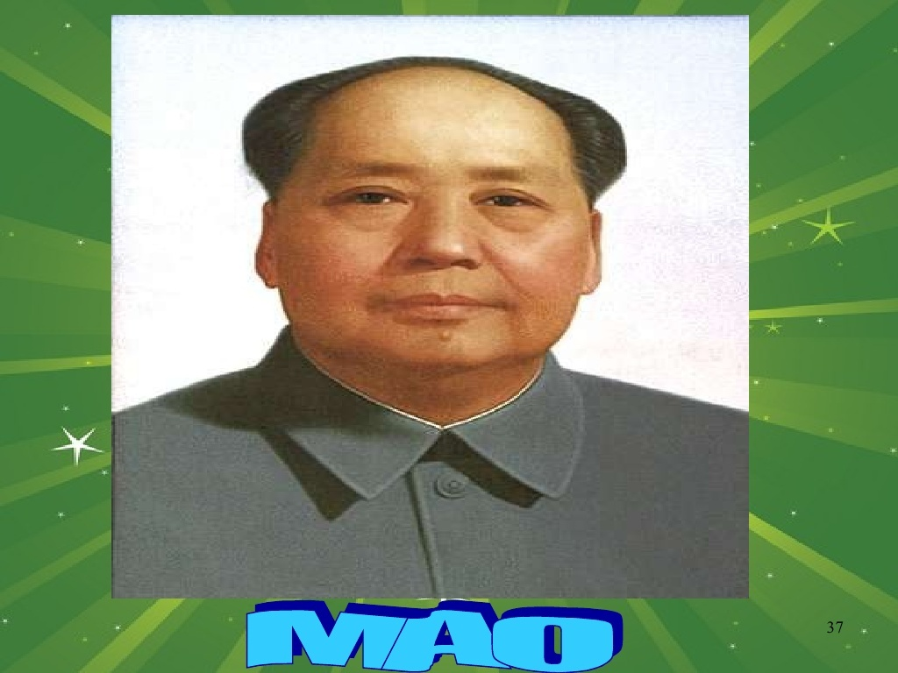

Slide 25
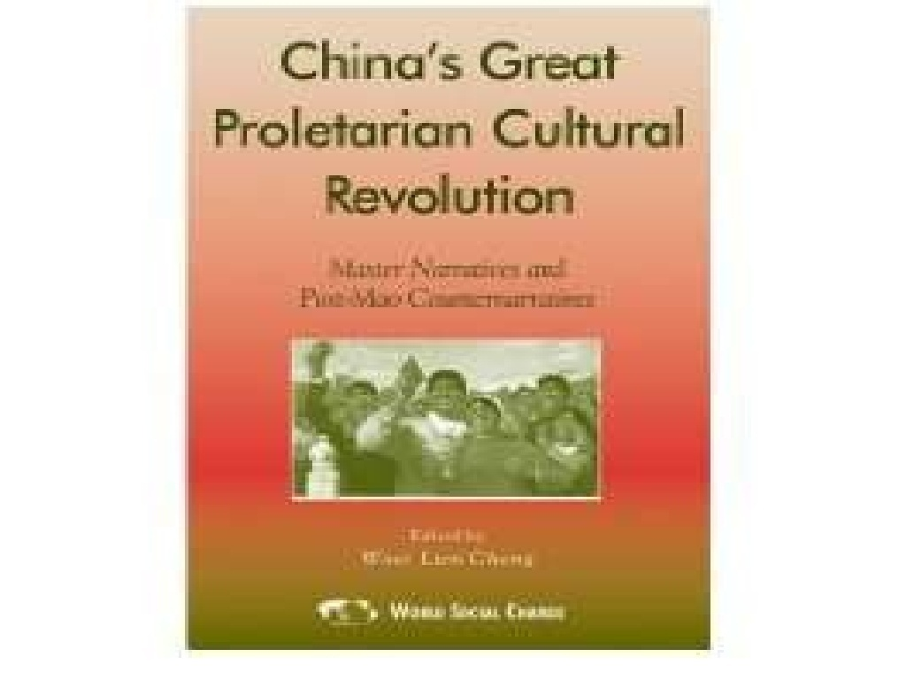

Slide 36
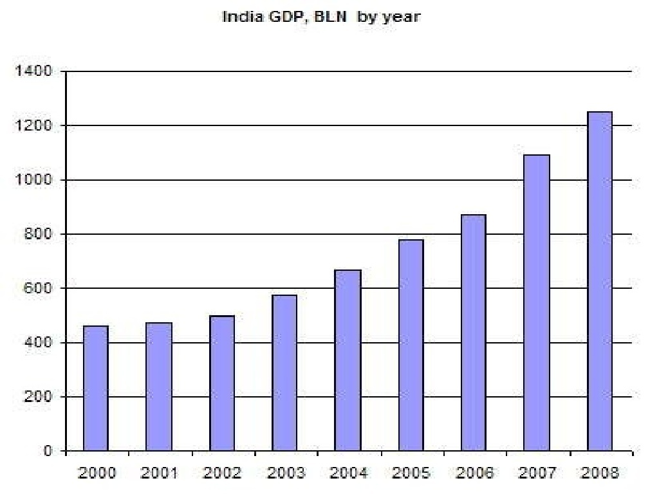

Slide 37
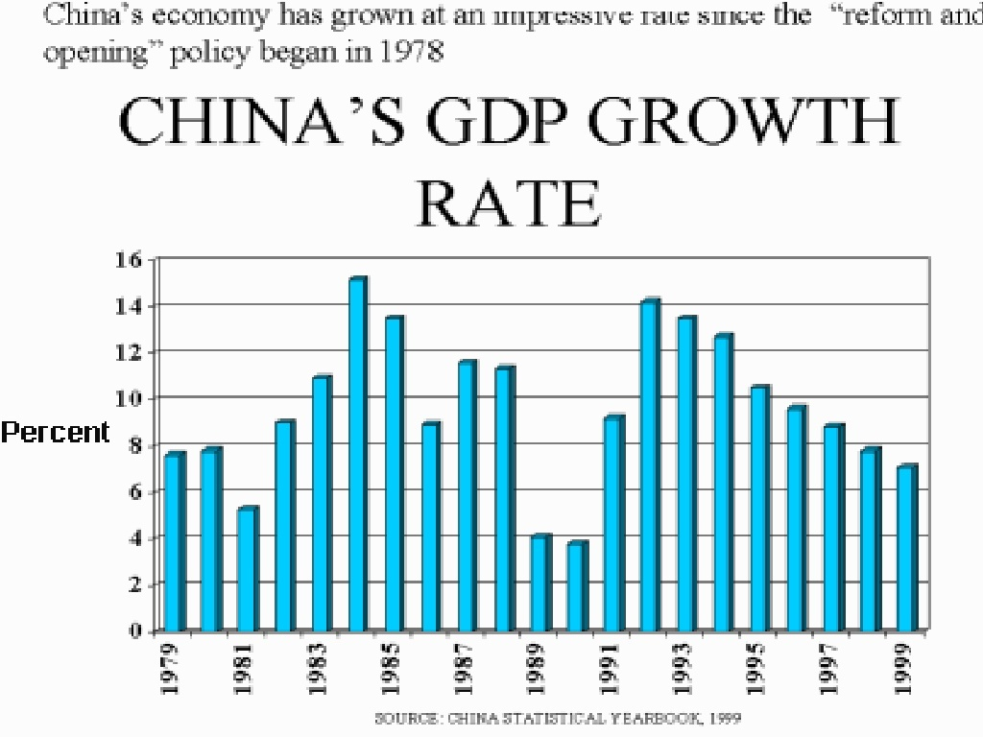

Slide 38
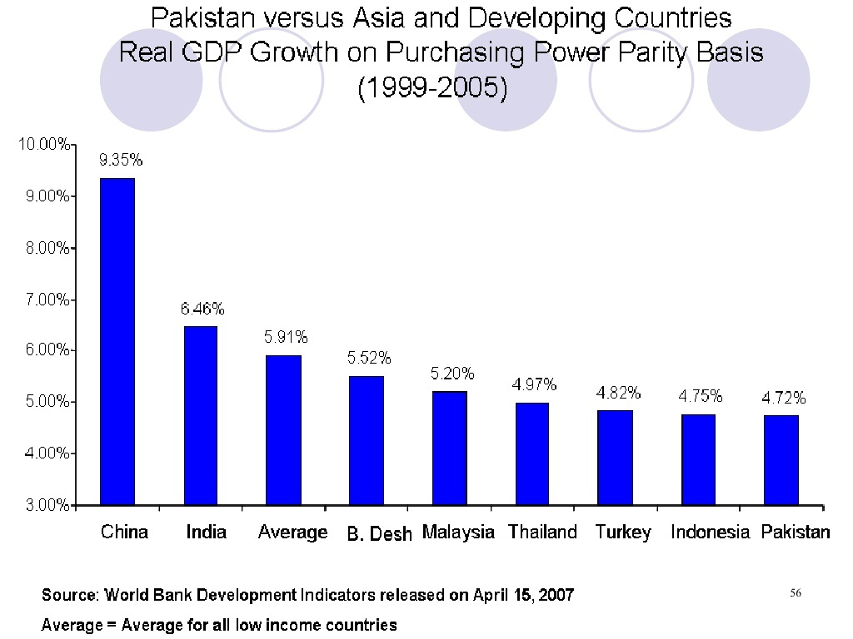

Slide 41
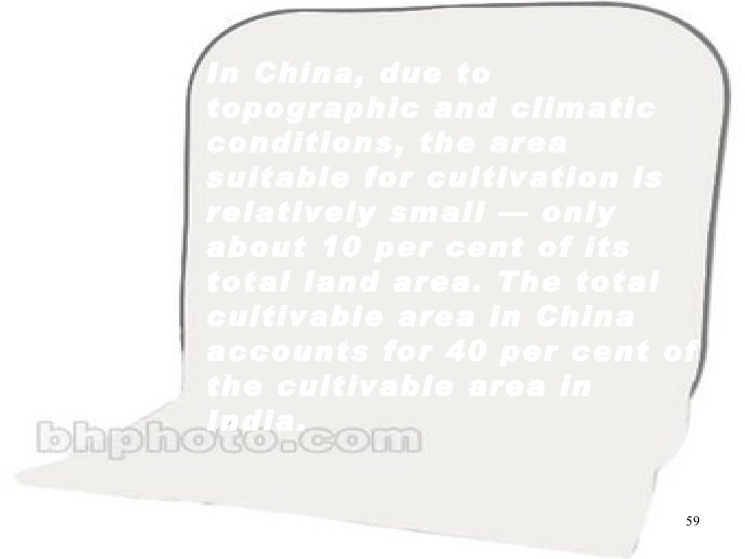

Slide 42
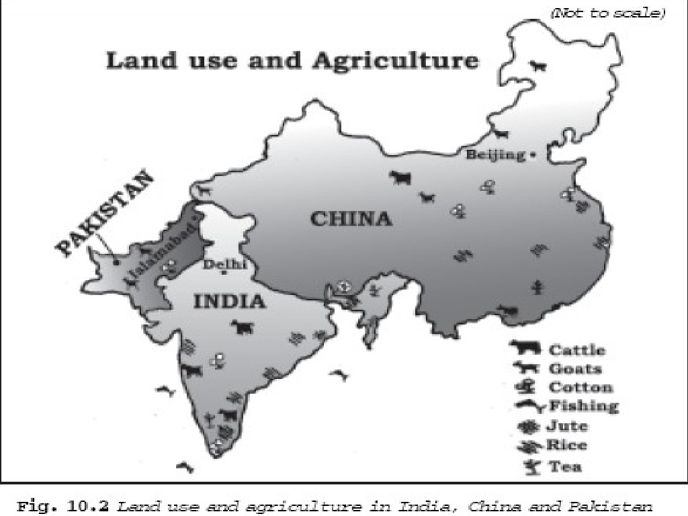

Slide 45
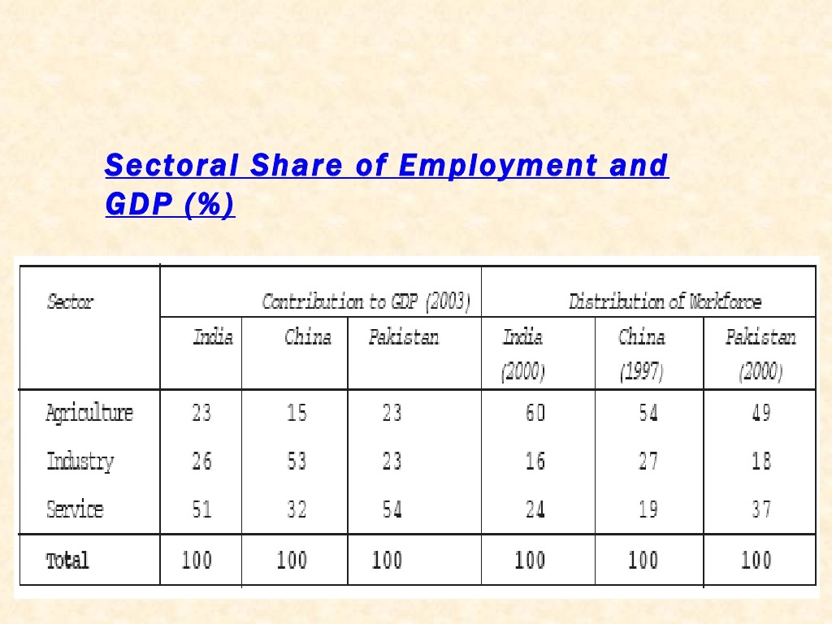

Slide 48
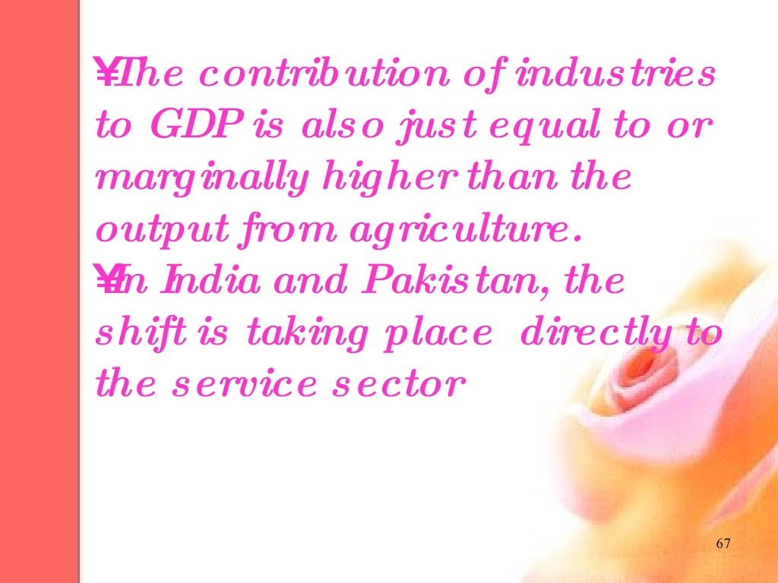

Slide 54
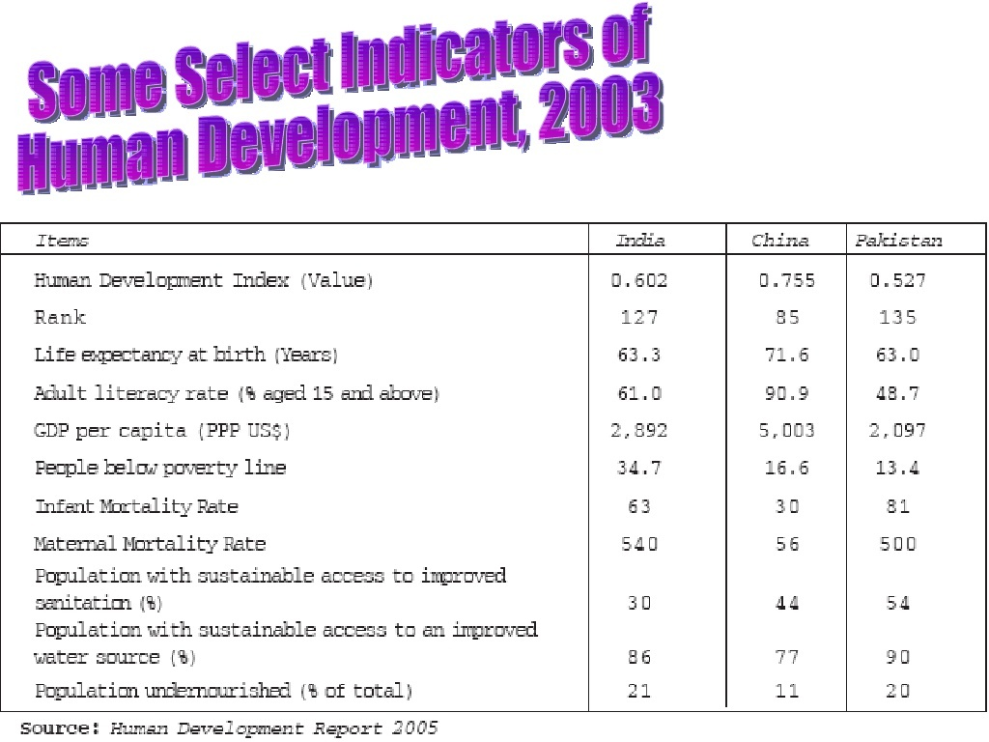

Slide 68
India, with democratic institutions, performed moderately, but the majority of its people still depend on agriculture. Infrastructure is lacking in many parts of the country. It is yet to raise the Standard of living of more than one-fourth of its population that lives below the poverty line.
On the other hand, the lack of political freedom and its implications in China are the major concern in the last two decades. The country used the market system without losing political commitment and succeeded in raising the level of growth along with poverty alleviation. China used the market mechanism to create additional social and economic opportunities. The country has also ensured social security in the rural areas by retaining collective farming known as Commune System. Public intervention in social infrastructure prior to the introduction of the economic reforms has brought positive results in the human development indicators of China.

Slide 69
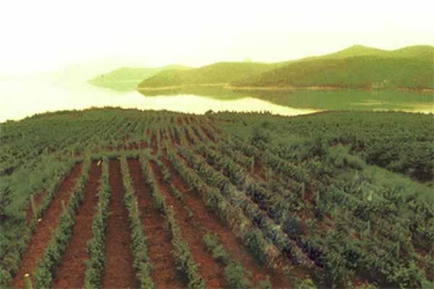
Conclusion: India & Pakistan
A. India-India performed moderately as is clear from
a. A majority of its people still depend on agriculture.
b. Infrastructure is lacking in many parts of the country.
c. It is yet to raise the level of living of more than 22% of its population that lives below the poverty line.
B. Pakistan-Pakistan has performed poorly. The reasons for the slowdown of growth and re-emergence of poverty in Pakistan’s economy are:
(i) Political instability.
(ii) Volatile performance of agriculture sector.
(iii) Over dependence on remittances.
(iv) Growing dependence on foreign loans on the one hand and increasing difficulty in paying back the loans on the other.

Slide 70
